Slide 1
Middle School CTE
Alyssa Johnston,
Career Development Coordinator
2.21.2018
goo.gl/B6GLjm

Slide 2
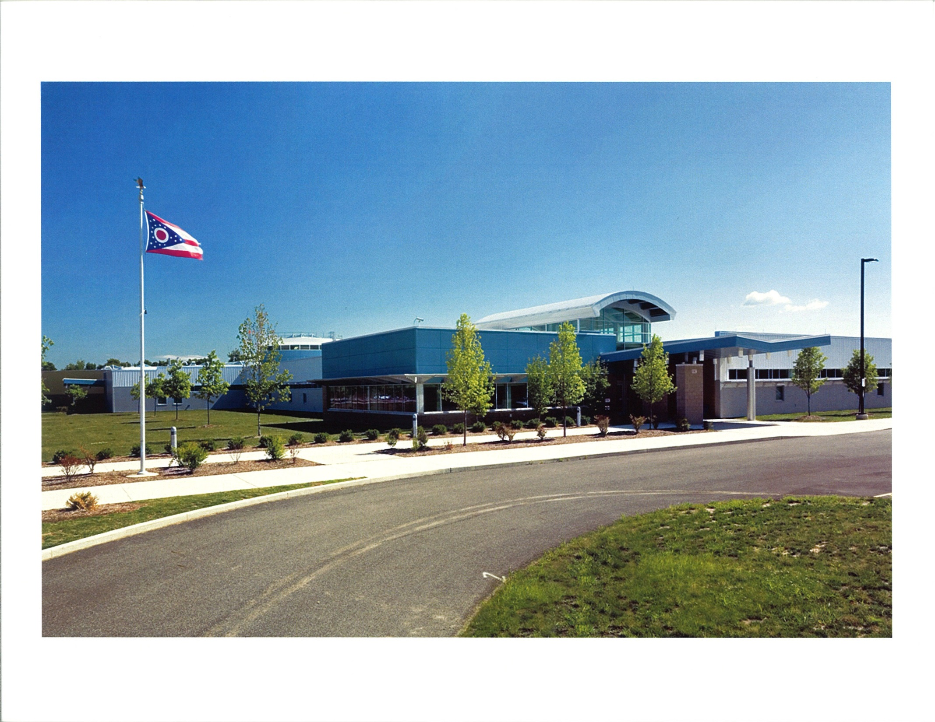

Slide 3
C-TEC: Overview
11 Associate Schools
Approximately 700 students on site
20 Jr/Sr Programs on campus
7 High School Satellite Programs
  Adding 1 next year
8 Middle School Programs
  Adding 1 next year
Adult Education

Slide 4
Career Development K-12
K-5
  Teacher PD
  Classroom Visits
  Career Day Activities
6-8
  Teacher PD
  Middle School Program support
    (owned and unowned)
  8th Grade Experience
9-12
  9th Grade: Requested Activities
  10th Grade: Sophomore Hands-On & Evening of Exploration
  11th Grade: CareerXpress & Project Prepare
  12th Grade: Senior Spotlight & Requested Activities
All grade levels- Open House & Evening of Exploration

Slide 5
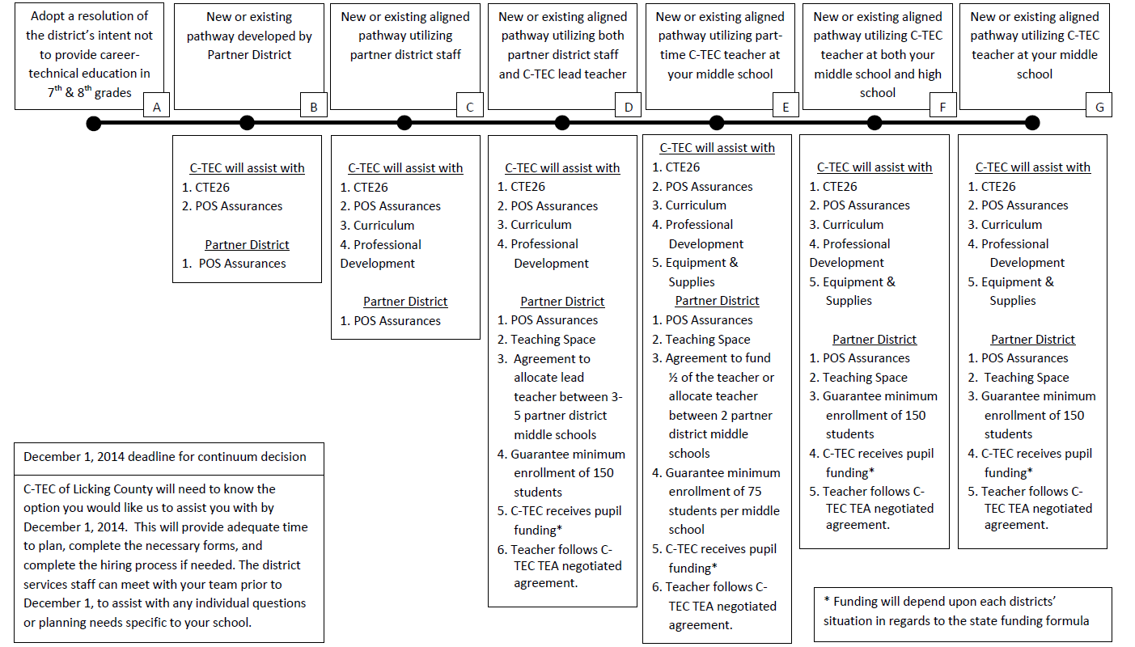
Middle School Collaboration Continuum

Slide 6
Middle School Programs:
Heath: Pre-Engineering
Licking Heights: Career Connections
Utica: Career Connections
Heath: Career Connections
Lakewood: Information Technology
Granville: Information Technology
Licking Valley: Pre-Engineering
Licking Heights: Pre-Engineering

Slide 7
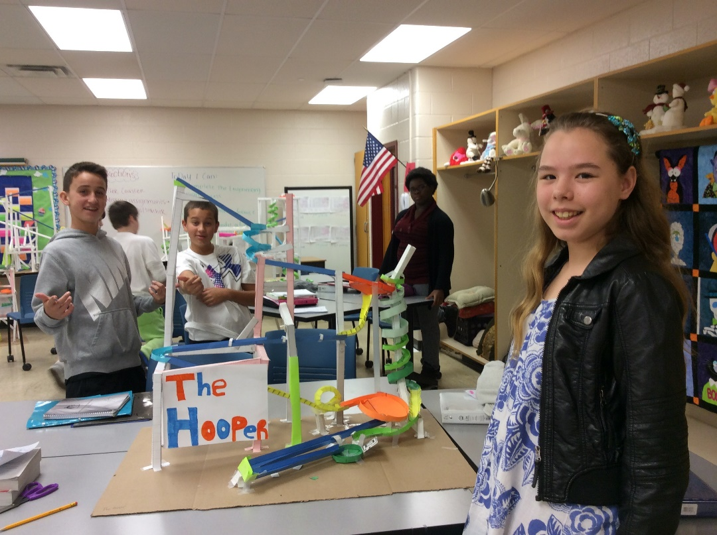
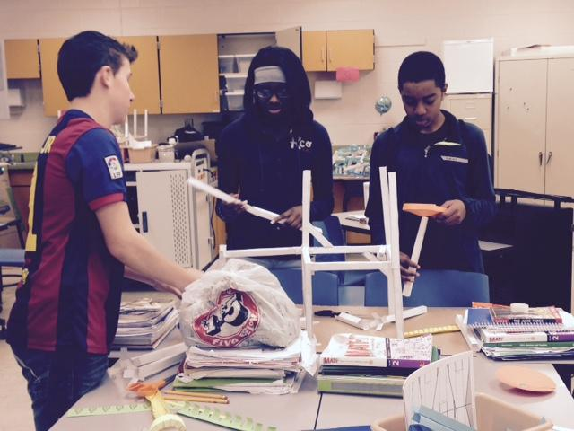
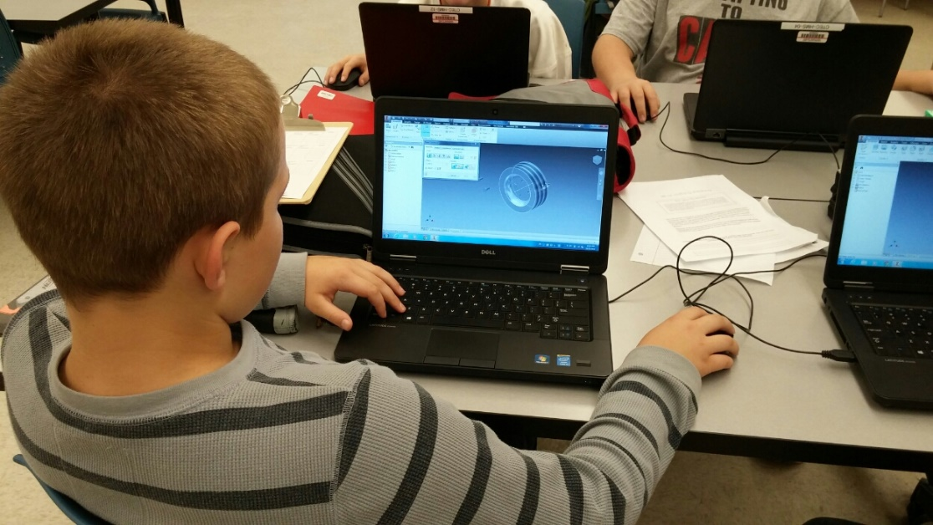
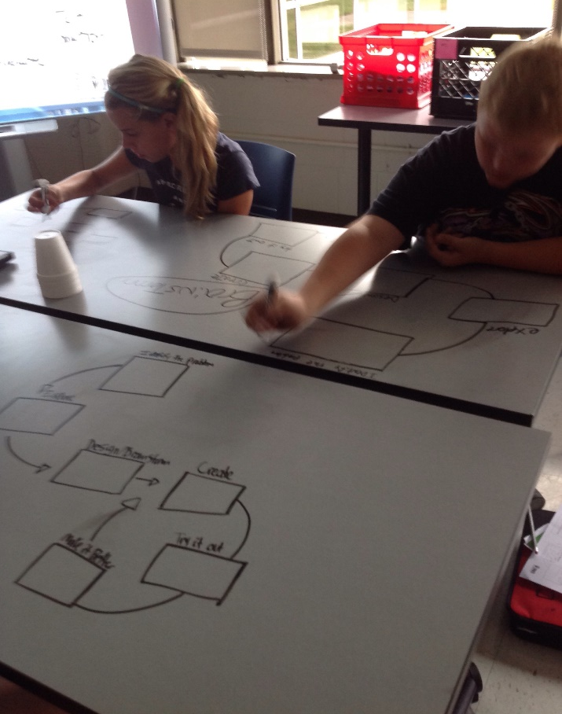

Slide 8
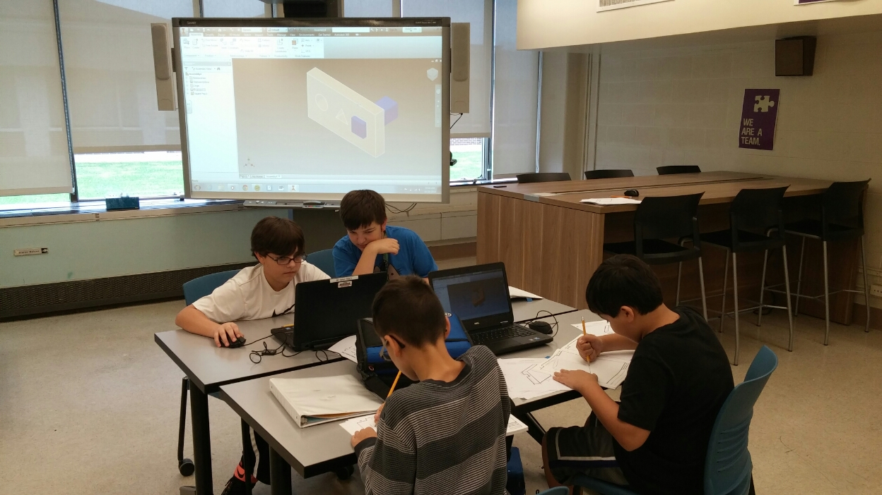
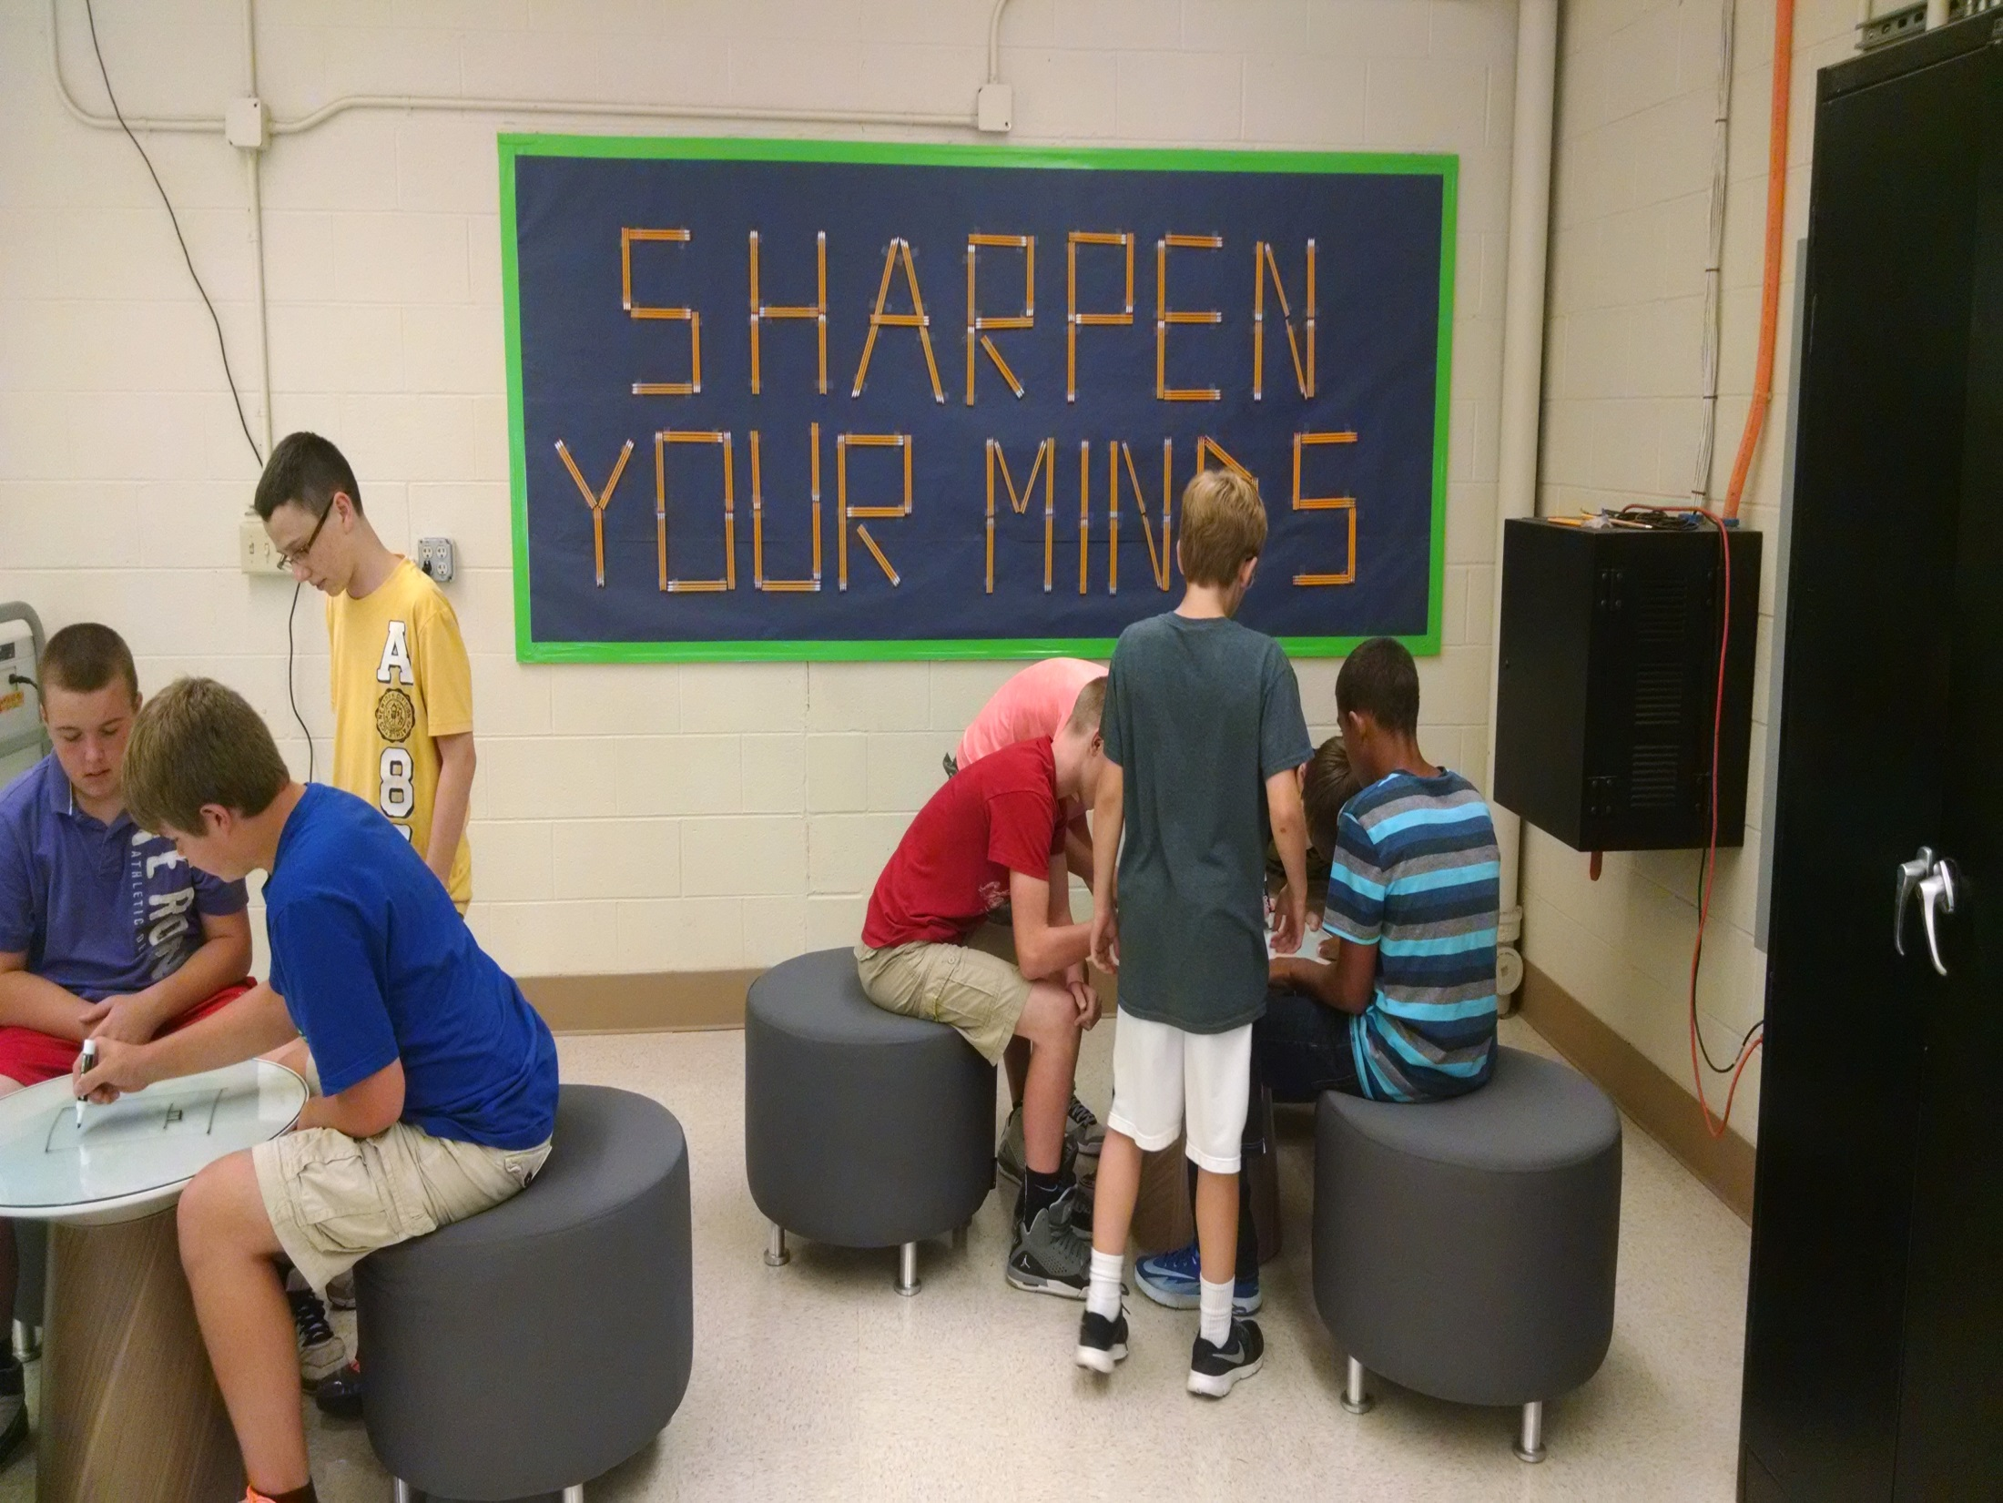
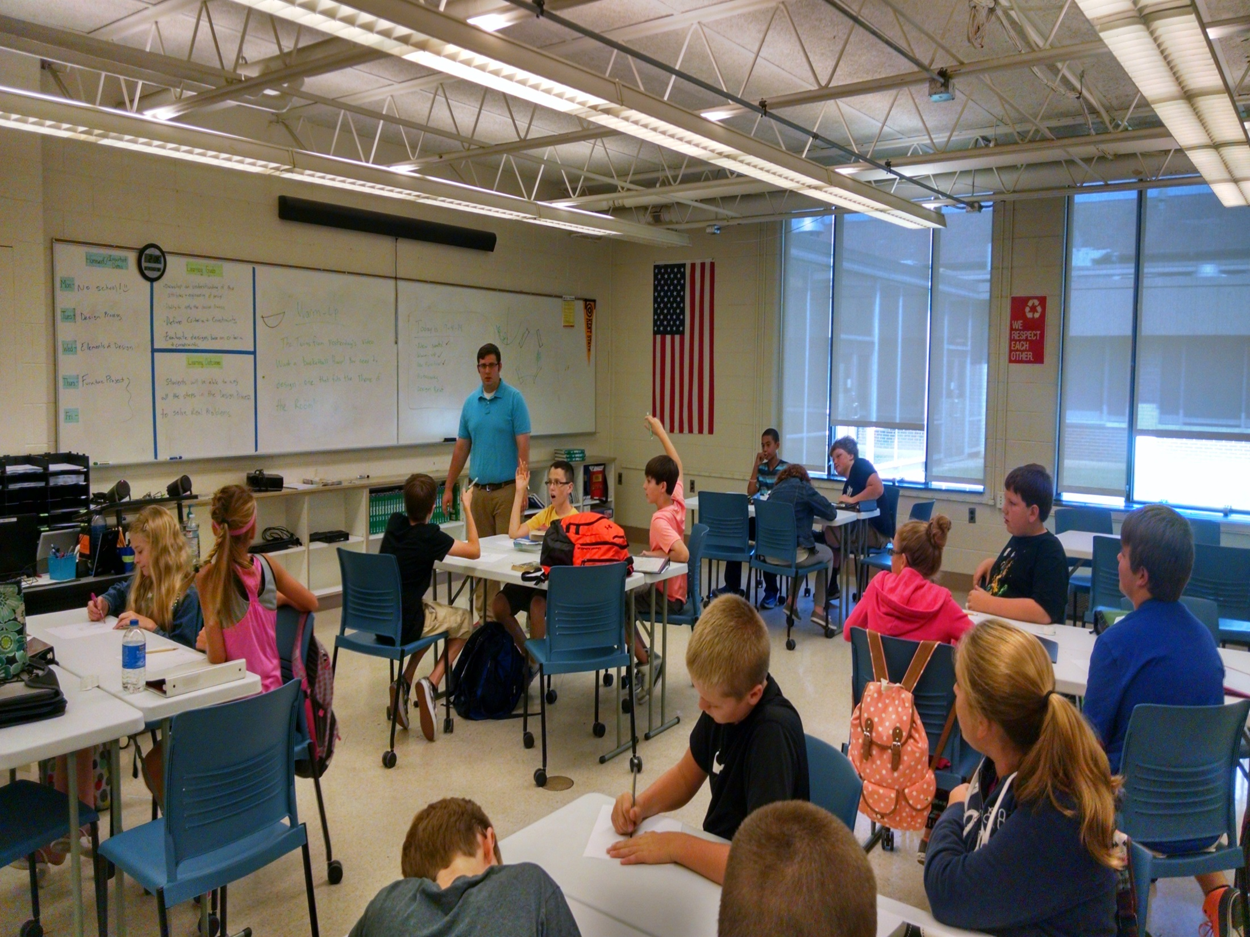



Slide 9
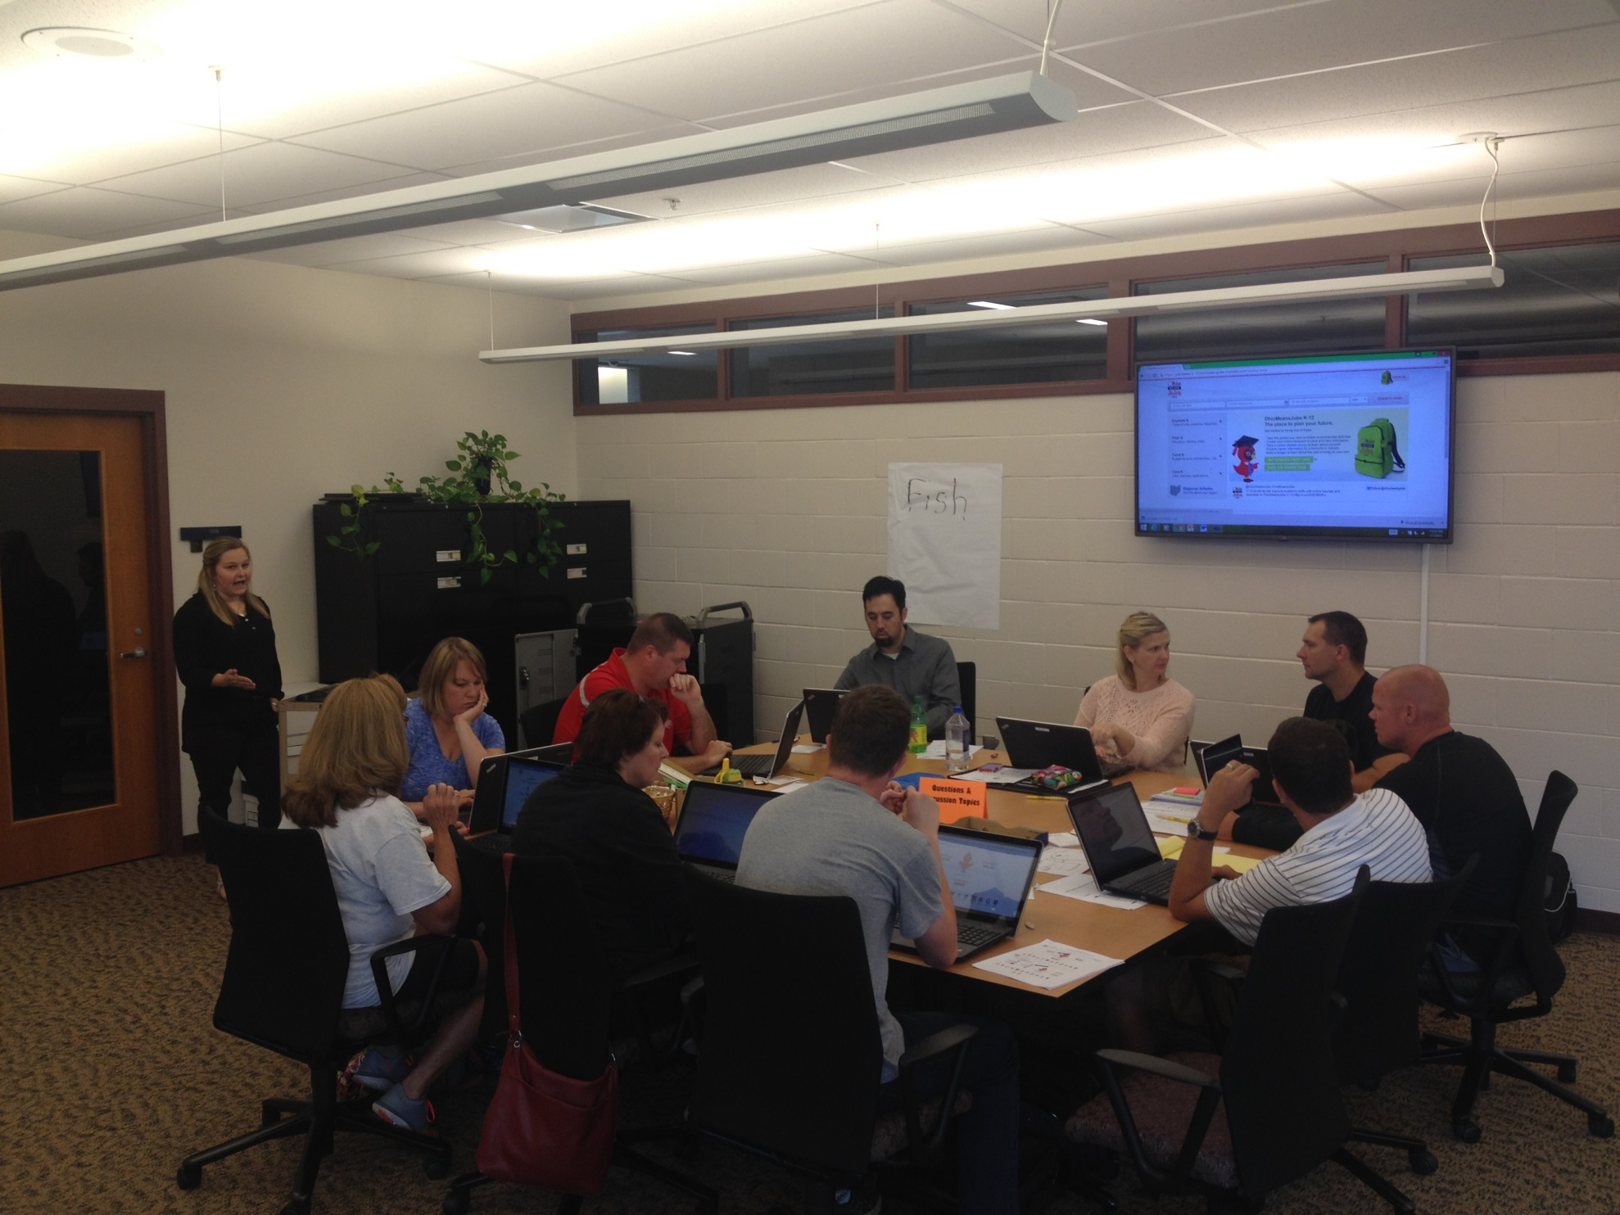
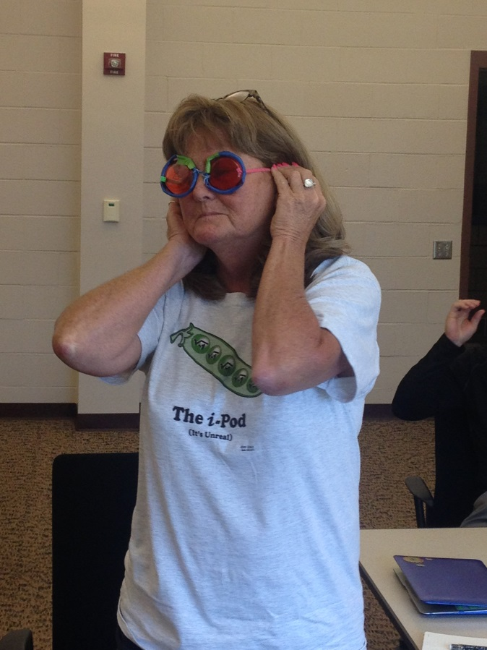
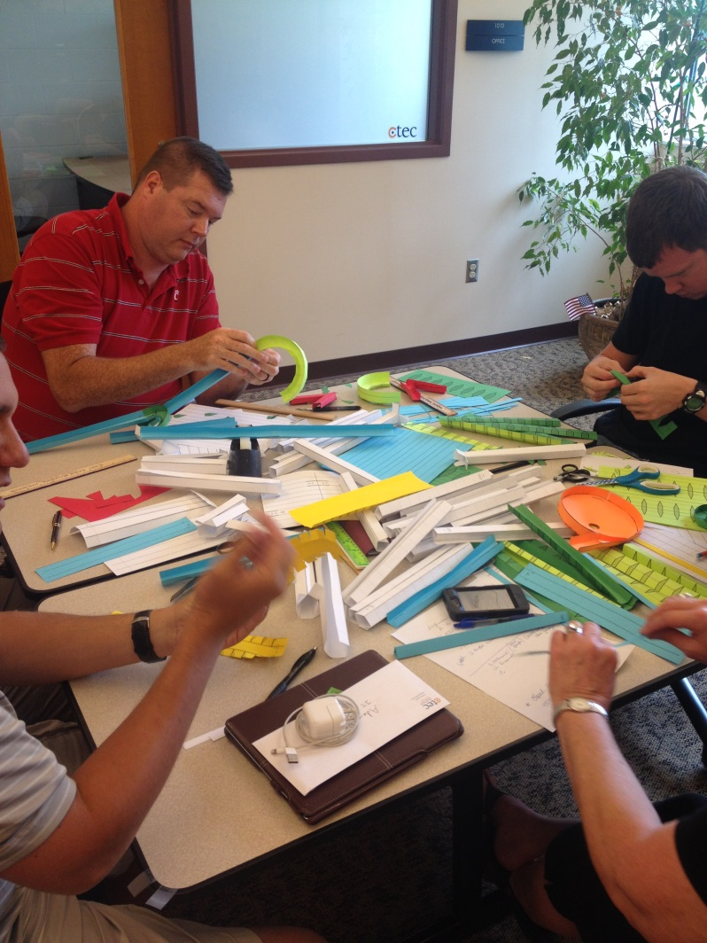
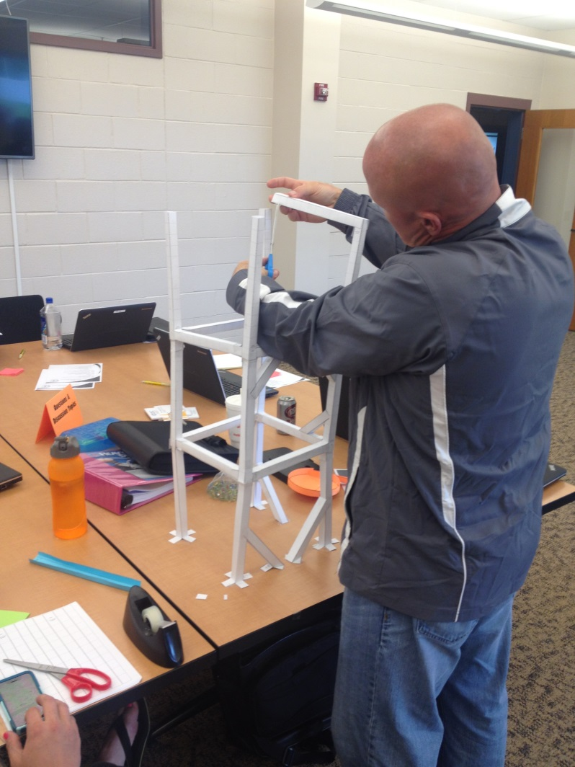
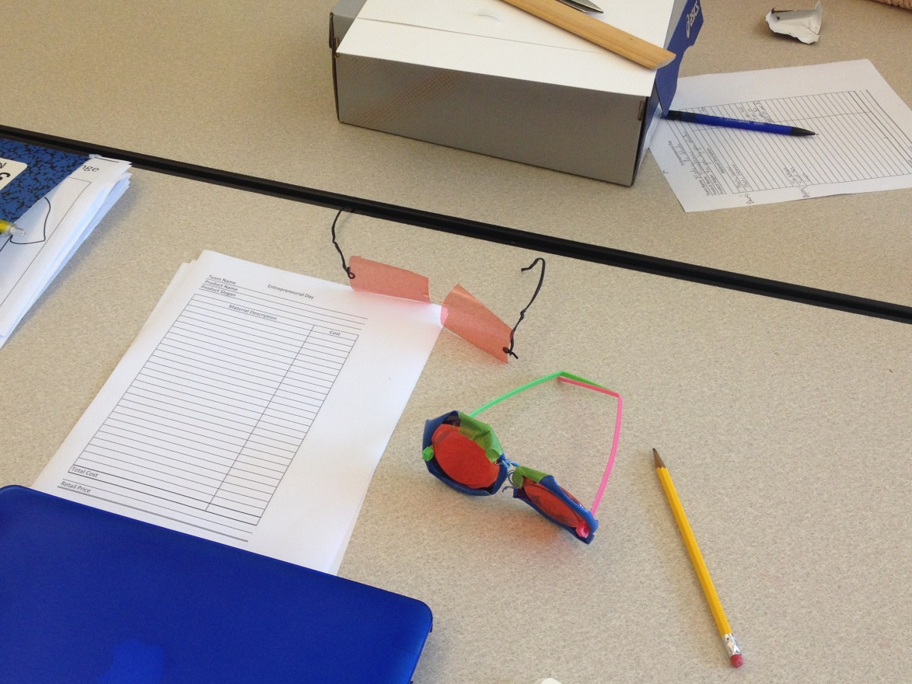

Slide 10
What can this look like for you?
  Model 1
  Larger District Model
Students can elect to take CTE course(s)
Semester elective
Open to 7th & 8th graders
Run A/B curriculum so if student takes in both 7th and 8th grade they can. A does not need to be a pre-req for B.
Example: Licking Heights Pre-Engineering and Career Connections
  Model 2
  Smaller District Model
Entire grade level takes CTE course
Either year long or semester
7th & 8th graders still target but choose one or both depending on size so that you are able reach all students
8th Grade course can build off 7th grade course since all students take both.
Examples: Heath Career Connections 7th grade and Pre-Engineering 8th grade.
Lakewood: Intro to IT for all 7th graders. Half take in semester 1 and other half in semester 2
  Model 3
  Small/Medium District Model
Every student takes the course sometime between 6th-8th grade (funding for 6th grade is not CT)
Either year long or semester depending on number of students
Scheduling is not as simple but does accommodate if your district sends grade levels to electives all at once.
Examples: Licking Valley Pre-Engineering 6th grade periods 1 & 2, 7th grade periods 3 & 4, 8th grade periods 7 & 8.

Slide 11
Other Districts:
Career Connections- during “IE” (30 minutes that back up lunch) students rotate through different career pathways. Each teacher takes different pathway.
Teacher split between Pre-Engineering (elective) 4 periods a day and Science 2 periods a day.
One teacher teachers Career Connections A/B to all students. 7th Grade 1st semester and 8th grade second semester.
One CTE teacher teaches High School and Middle School courses

Slide 12


Thank you!
For more information:
On the web visit www.c-tec.edu
Check us out on :
ctec/education
@cteclickingco
QUESTIONS?

